Slide 1



Exhaustive Analysis Of
Indian Agriculture
Presented By
Nagaraju Poralla

Slide 2

Learning Objectives
Understand Agricultural Trends – Analyze historical and real-time data to identify patterns in crop production, yield, and distribution across different regions of India.
Visualize Agricultural Data – Utilize interactive graphs, charts, and maps to represent crop distribution across states and years.
Compare Inter-State Production – Compare agricultural output across states to determine the leading producers for various crops.
Track Yearly Trends – Observe changes in crop production across years to identify growth patterns, declines, or shifts in cultivation.
GOAL
Source :
www.freepik.com/

Slide 3
Tools and Technology used:
Power BI – Used for data visualization and dashboard creation, enabling interactive analysis through graphs, slicers, and filters.
CSV File - Data source containing state-wise crop production records over different years.
Power Query – Utilized for cleaning, transforming, and preparing data before visualization.
Data Visualization Components:
Graphs & Charts – Bar charts, line charts, pie charts, donut chart and treemaps to represent production trends.
Slicers – Interactive filters to analyze crop production across states and years.
Custom Power BI Themes – To improve dashboard aesthetics.

Slide 4
Methodology
Data Collection: Gathered crop production data from CSV files, containing details of crop types, production quantity, states, and years.
2. Data Preprocessing & Cleaning:
Imported CSV data into Power BI using Power Query.
Performed data cleaning:
Removed duplicate and inconsistent records.
Handled missing values by applying interpolation or removing incomplete rows.
Standardized column names and data types for consistency.
3. Data Visualization & Dashboard Development:
Created an interactive dashboard in Power BI, featuring:
Bar & Column Charts – Comparing crop production across states.
Line Charts – Showing trends over multiple years.
Pie & Donut Charts – Displaying proportional crop production by state.
Treemaps – Illustrating hierarchical relationships between crops and states.

Slide 5
Problem Statement:
State-wise Crop Production Comparison
There is a lack of clear visualization showing which state produces how much of a particular crop, making it difficult to compare agricultural output across regions.
Year-wise Crop Production Trends
Analyzing how crop production has changed over different years is challenging without a proper trend analysis, leading to difficulty in understanding long-term agricultural patterns.
Total Production by Each State
A comprehensive view of the total agricultural output per state is needed to assess which states contribute the most to national food production.
Top Crop-Producing States for a Given Year
Identifying the leading states for specific crops in any given year is difficult due to large datasets and lack of intuitive data filtering.
Interactive Analysis of Crop Distribution
Traditional reports do not provide interactive elements such as slicers, making it cumbersome to filter and analyze data by state, crop, or year dynamically.
Historical vs. Recent Crop Production Analysis
Identifying shifts in crop production patterns over the years is challenging without a time-series visualization.

Slide 6
Solution:
1. State-wise Crop Production Visualization
A bar chart and treemap display total crop production for each state, allowing users to quickly compare agricultural output across regions.
2. Year-wise Crop Production Trends
Line charts and pie charts track historical crop production trends, helping users analyze long-term agricultural patterns and growth.
3. Total Production by Each State
A ranking-based visualization (sorted bar chart) showcases the highest and lowest producing states, making it easy to assess their contributions to national agriculture.
4. Top Crop-Producing States for a Given Year
Slicers and filters enable users to select a specific year and see the top-producing states for that period in real time.
5. Interactive Crop Distribution Analysis
Dynamic slicers allow users to filter data by crop and year, enabling customized analysis and deeper insights.
This interactive dashboard provides a data-driven solution for policymakers, agribusinesses, and researchers, making agriculture analysis more accessible, insightful, and actionable.

Slide 7
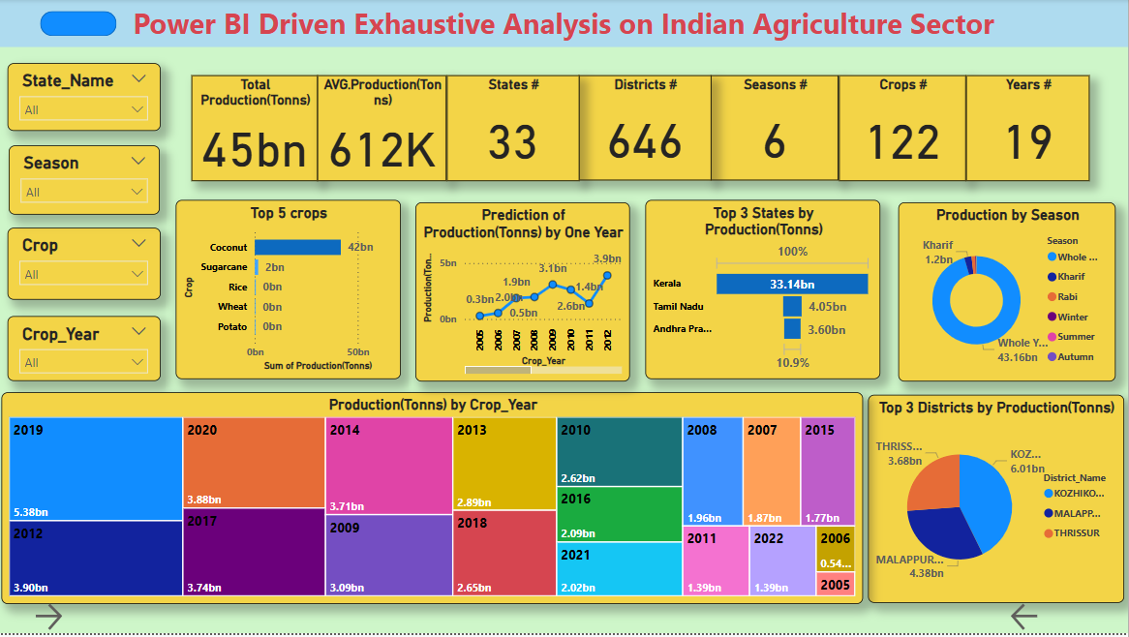
Screenshot of Output:

Slide 8
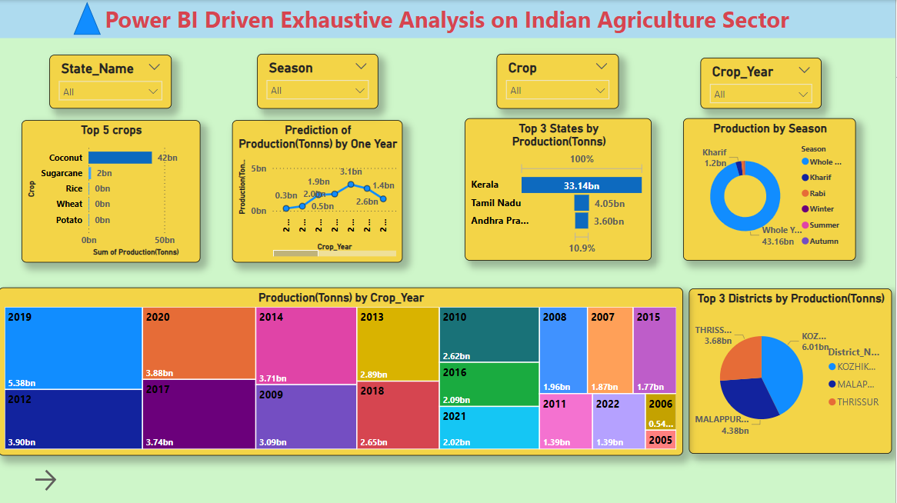
Screenshot of Output:

Slide 9
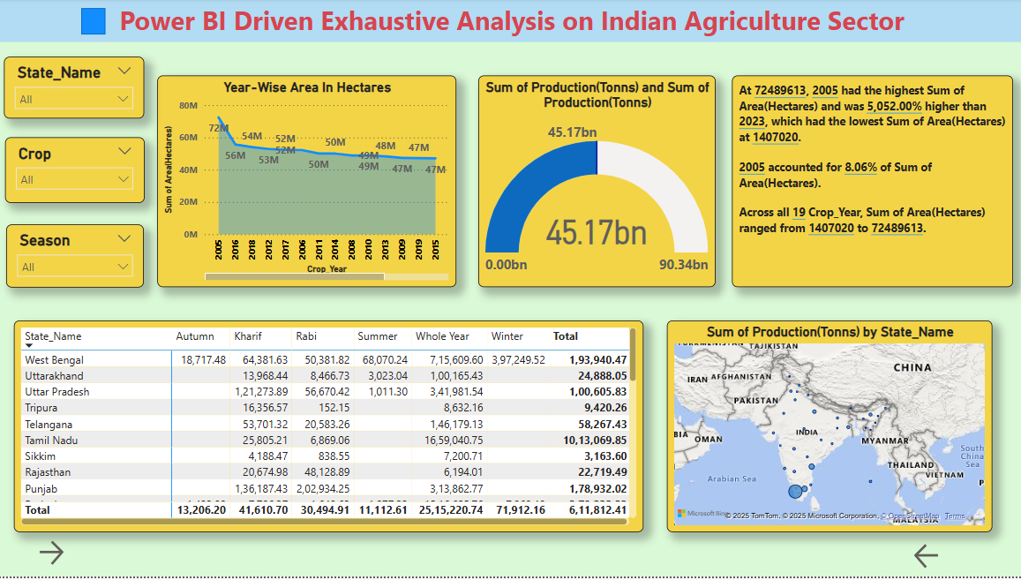
Screenshot of Output:

Slide 10
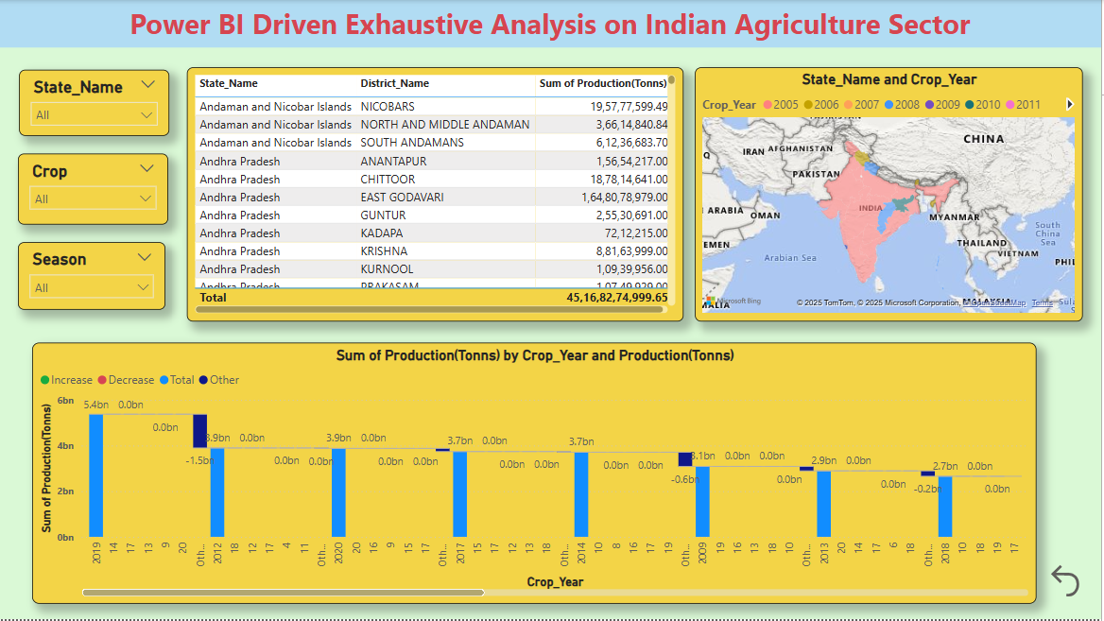
Screenshot of Output:

Slide 11
Conclusion:
The Indian Agriculture Analysis Dashboard provides an interactive, data-driven approach to understanding state-wise crop production trends over different years. By leveraging Power BI and CSV-based datasets, the dashboard effectively visualizes key agricultural insights, enabling users to analyze which state produces which crop in what year with ease.
Through various charts, graphs and slicers, the dashboard allows policymakers, researchers, and stakeholders to: Identify top crop-producing states and track historical trends. Compare state-wise agricultural output dynamically. Explore yearly production shifts to understand changing farming patterns. Gain insights into regional crop distribution for better decision-making.
The interactive filtering and drill-down functionalities ensure that users can extract meaningful insights tailored to their needs.
In the future, integration with real-time data sources and machine learning models can further enhance the dashboard’s capabilities, providing even deeper insights into the evolving landscape of Indian agriculture.

